Slide 1

Using Deep learning to Predict Plant Growth and yield in the greenhouse Environments
SUPERVISOR BATCH MEMBER
Name , Student1 Name (Reg no)
Designation, Student2 Name (Reg no)
. Department Student3 Name (Reg no)

Slide 2
CONTENTS OF THE PROJECT
Objective
Literature Survey- Min 10 papers
Existing System and Drawbacks
Problem statement
Proposed System Diagram
List of Modules
Expected Outcome
References

Slide 3
OBJECTIVE
predicting ficus plant growth/crop yield by evaluating performance of various machine learning algorithms such as SVR (Support Vector Regression), Random Forest Regression (RF) and LSTM (Long Short Term Memory) deep neural network algorithm. SVR and RF are the traditional old algorithms whose performance of prediction will be low due to unavailable of deep learning technique.

Slide 4
LITERATURE SURVEY
S.NO | TITLE OF THE PROJECT | AUTHOR NAME | JOURNAL | METHOD AND DESCRIPTION | DRAWBACKS | YEAR
1. | Tompousse, a model of yield prediction for tomato crops: calibration study for unheated plastic greenhouses. | P. Abreu, J.F. Meneses, C. Gary | International Horticultural Congress | a data set of three production cycles was used to calibrate some growth and development relations of the model and to assess the quality of the simulations | Tompousse was selected because it requires a little amount of climatic and crop data which is an important aspect at the grower's level. | 1998
2. | Predicting the weekly fluctuations in glasshouse tomato yields | S.R. Adams | International Symposium on Models for Plant Growth and Control in Greenhouses | This paper reports on progress in quantifying these relationships and in developing a model that can be used by growers, combined with better weather forecasting systems, for prediction of crop yields. Such a system should also provide information on how the aerial environment can be manipulated to modify the pattern of yield. | They have only initialized the problem. | 2015

Slide 5

EXISTING SYSTEM
Effective plant growth and yield prediction is an essential task for greenhouse growers and for agriculture in general. Developing models which can effectively model growth and yield can help growers improve the environmental control for better production, match supply and market demand and lower costs. Recent developments in Machine Learning (ML) and, in particular, Deep Learning (DL) can provide powerful new analytical tools. The proposed study utilises ML and DL techniques to predict yield and plant growth variation across two different scenarios, tomato yield forecasting and Ficus benjamina stem growth, in controlled greenhouse environments.

Slide 6
Drawback of the Existing System
Deep Learning extends classical ML by adding more "depth" (complexity) into the model, as well as transforming the data using various functions that create data representations in a hierarchical way, through several levels of abstraction.
A strong advantage of DL is feature learning, i.e., automatic feature extraction from raw data, with features in higher levels of the hierarchy being formed through composition of lower level features.
DL can solve complex problems particularly well and fast, due to the more complex models used, which also allow massive parallelization

Slide 7
PROBLEM DEFINITION
Growth, yield rate, tomato, ficus, stem diameter, prediction, deep learning, recurrent LSTM neural networks

Slide 8

PROPOSED SYSTEM
We deploy a new deep recurrent neural network (RNN), using the Long Short-Term Memory (LSTM) neuron model, in the prediction formulations. Both the former yield, growth and stem diameter values, as well as the microclimate conditions, are used by the RNN architecture to model the targeted growth parameters. A comparative study is presented, using ML methods, such as support vector regression and random forest regression, utilising the mean square error criterion, in order to evaluate the performance achieved by the different methods. Very promising results, based on data that have been obtained from two greenhouses, in Belgium and the UK, in the framework of the EU Interreg SMARTGREEN project (2017-2021), are presented.

Slide 9
ARCHITECTURE DIAGRAM

Slide 10

LIST OF MODULES
upload dataset: using this module we will upload FICUS plant dataset
Dataset cleaning: using this module we will find out empty values in the dataset and replace with mean or 0 values.
Train & Test Split: Using this module we will split dataset into two parts called and training and testing. All machine learning algorithms take 80% dataset to train classifier and 20% dataset is used to test classifier prediction accuracy. If classifier prediction accuracy high then Mean Square Error, Root Mean Square Error and Mean Absolute Error will be dropped.
Run SVR Classifier: Using this module we will train SVR classifier with splitted 80% data and used 20% data to calculate it performance
Run Random Forest Classifier: Using this module we will train Random Forest classifier with splitted 80% data and used 20% data to calculate it performance
Run LSTM Classifier: Using this module we will train LSTM classifier with splitted 80% data and used 20% data to calculate it performance
Predict Plant & Yield Growth: Using this module we will upload test data and then apply LSTM classifier to predict it growth value

Slide 11
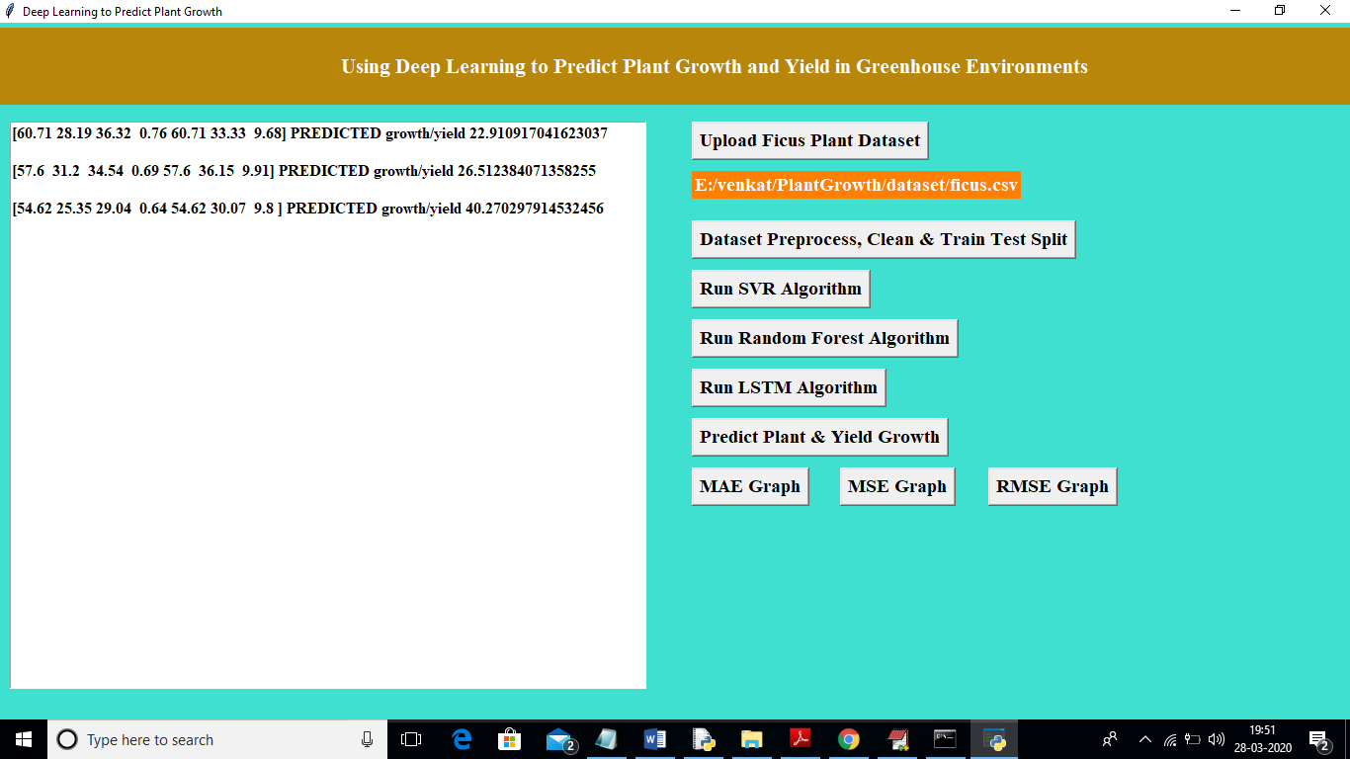
Expected Outcome/Result

Slide 12
REFERENCES
1.Abreu, P., Meneses, J. & Gary, C. 1998, "Tompousse, a model of yield prediction for tomato crops: calibration study for unheated plastic greenhouses", XXV International Horticultural Congress, Part 9: Computers and Automation, Electronic Information in Horticulture 519, pp. 141.
2. Adams, S. 2001, "Predicting the weekly fluctuations in glasshouse tomato yields", IV International Symposium on Models for Plant Growth and Control in Greenhouses: Modeling for the 21st Century-Agronomic and 593, pp. 19.
Atanasova, N., Todorovski, L., Džeroski, S. & Kompare, B. 2008, "Application of automated model discovery from data and expert knowledge to a real-world domain: Lake Glumsø", Ecological Modelling, vol. 212, no. 1-2, pp. 92-98.

Slide 13
THANK YOU

